Slide 1

AI-Based Fake Image Detection System
University Of Ghana
Department of Computer Engineering
Christell Tawiah - 10898029
Aboagye Fafa - 10922580
Baah Nana Kwadwo Asare - 10907896
Supervisor: Dr. Nii Longdon S.
November 17, 2023

Slide 2
Presentation Outline
Methodology
Materials Requirements and logistics
Expected Output
Conclusion
References
Introduction
Problem Statement
Project Relevance
Existing Works
Proposed Solution
Objectives

Slide 3
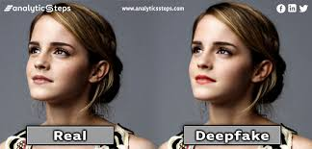
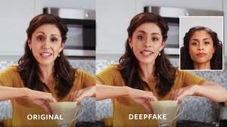
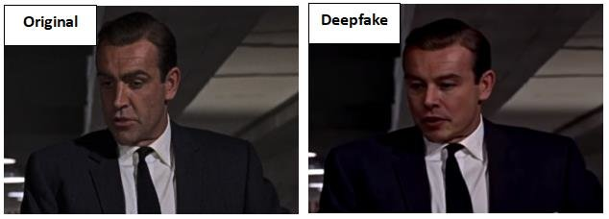
Introduction
The Rise of Deep fakes
Deepfakes are synthetic media that are created using AI and machine learning algorithms.
The proliferation of deepfakes poses a significant threat to privacy, security, and trust.
Detecting and combating deepfakes is essential for safeguarding against misinformation and manipulation.

Slide 4

Introduction
According to a recent study by the RAND Corporation, over 100,000 AI-generated images were uploaded to social media platforms in 2021 alone. [1]
In 2020, a fake image of Pope Francis smoking a cigarette circulated.

Slide 5
Problem Statement
The proliferation of fake and AI-generated images on the internet has led to an increase in misinformation and fraudulent activities.
The lack of an effective solution for detecting fake or AI-generated images poses a significant threat to online content authenticity and trustworthiness.
Existing image verification systems are inadequate to identify and filter out fake or AI-generated images.

Slide 6
Project Relevance
Digital Era Challenges :
The prevalence of AI-generated images introduces challenges to online integrity and user trust.
User Security Concerns and authenticity assurance:
Deceptive practices like: Fake Product Listings, Identity Fraud, Misleading Content, Impersonation leading to fraud.
Trustworthiness Of Digital Content:
Maintaining the trustworthiness of digital interactions.

Slide 7
Literature Review
Title/Authors /Year | Objectives / Aim | Methods and Achievements | Research Gaps
Image splicing detection based on convolutional neural networks (Ye, D., Qian, Y., Long, R., & Shan, J., 2018). [7] | To develop a CNN-based method that can accurately detect image splicing with high accuracy. | Convolutional neural network (CNN) with CASIA dataset. 99.6% accuracy on the CASIA dataset | Limited to detecting splicing in specific image regions.
Image manipulation detection based on noise residual maps (Li, Y., Chang, S., & Chen, S., 2019). [8] | To develop a CNN-based method that can accurately detect image manipulation using noise residual maps. | Convolutional neural networks (CNNs) and support vector machines (SVMs) for feature extraction and classification. Achieved an accuracy of 99.1%Ensemble | Sensitive to noise and compression artefacts.

Slide 8
Literature Review
Title/Authors /Year | Objectives / Aim | Methods & Achievements | Research Gaps
Image forensics based on error level analysis (Wang, S., Wu, D., & Zhang, Y., 2020). [9] | To provide a comprehensive overview of image forensics techniques for detecting manipulated images, including GAN-generated images. | Error level analysis (ELA) with Columbia Image Dataset. Achieved a 98.5% accuracy on the Columbia Image Dataset | Need for more effective methods to detect sophisticated GAN manipulations that mimic real-world images. Limited to detecting specific types of manipulation
Image forensics using residual convolutional neural network (Afroz, S., Afroz, M. S., & Yamagishi, T., 2021) . [10] | To enhance the robustness of GAN-generated image detection by incorporating attention mechanisms into the detection model. | Residual convolutional neural network (RCNN) with FaceForensics++ dataset . Achieved 99.3% accuracy on the dataset. | Challenges in handling large-scale and complex GAN-generated images with high accuracy.

Slide 9
Literature Review
Title/Authors /Year | Objectives / Aim | Methods | Research Gaps
Image manipulation detection based on attention-based convolutional neural network (Liu, Y., Deng, S., & Wang, Z.-J., 2022). [11] | To detect GAN-generated images by analyzing image quality metrics and artifacts introduced by the GAN generation process. | Attention-based convolutional neural network (CNN) with DeepFakeForensics dataset. 99.7% accuracy on the DeepFakeForensics dataset. | Insufficient understanding of the underlying mechanisms and artifacts introduced by different GAN models.

Slide 10
Proposed Solution
A combination of deep learning approach, noise analysis and statistical analysis using convolutional neural networks (CNNs).
Focus more on the fine tuning of the Model to specifically train it on the flaws of GANs.
Generate synthetic AI-generated images to augment the dataset and collaboratively train detection models without compromising data privacy.

Slide 11
Objectives
01
02
Develop AI-based detection tools to enhance prediction accuracy, correctly identifying AI-generated fake faces while minimizing false positives.
Design a user-friendly website interface for the detection tools to make them accessible to a wide range of users, including those without extensive technical expertise.

Slide 12
Objectives
03
04
Develop robust and scalable detection methods that can effectively handle a wide range of AI-generated images.
use a standardized and comprehensive dataset that can be used for training and evaluating detection methods.

Slide 13
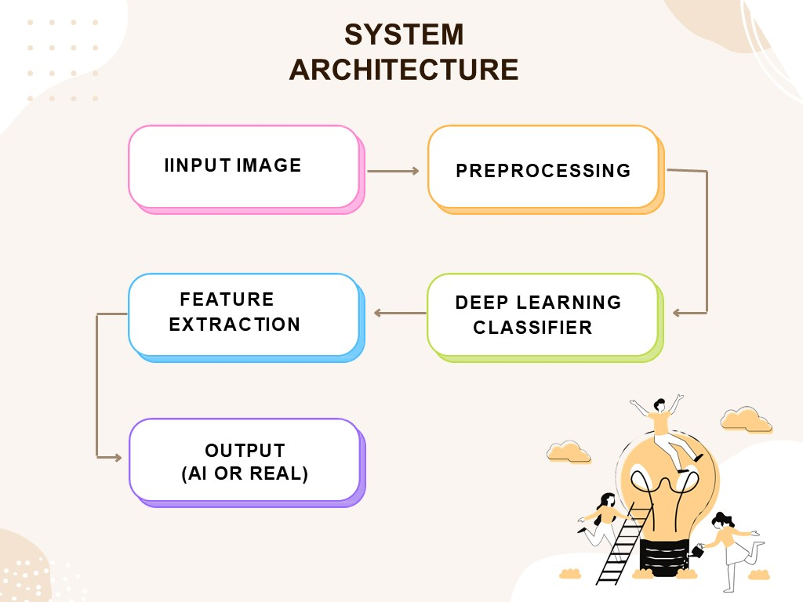

Slide 14
Methodology
01
02
01
Dataset Preparation
Acquire the BigDatasetGan dataset provided by Nvidia. Ensure its balanced and complete.
03
04
Preprocessing of images
05
02
By resizing, normalizing, and augmenting them to increase the model's generalization ability.
06
07
Feature Extraction
03
08
Utilize Resnet-152 to extract high level features relevant to the training of our model.Available online, and offered by TensorFlow Hub and PyTorch Hub.
09

Slide 15
Methodology
01
02
04
Selection of Classifier
Utilize Resnet-50 as our main convolutional Neural Network.ResNet-50 is a very accurate CNN.
03
04
Training Of Model
05
05
Split the dataset into training, validation, and test sets.
Train the classifier using the features extracted from the Resnet-150.Tune Hyper parameters etc.
06
07
06
Evaluation
08
Use metrics like accuracy, precision, recall, and F1 score to measure classification performance.
09

Slide 16
Methodology
01
02
07
Ensembling
03
Utilize weighted majority voting to generate a final output. Hierarchy is CNN, noise analysis, statistical analysis
04
Optimization
05
08
Utilize optimization methods such as adversarial testing and human-in-loop-verification to increase robustness
06
07
Continuous Learning
09
Periodically retrain the classifier with new data to adapt to evolving GAN techniques
08
09

Slide 17
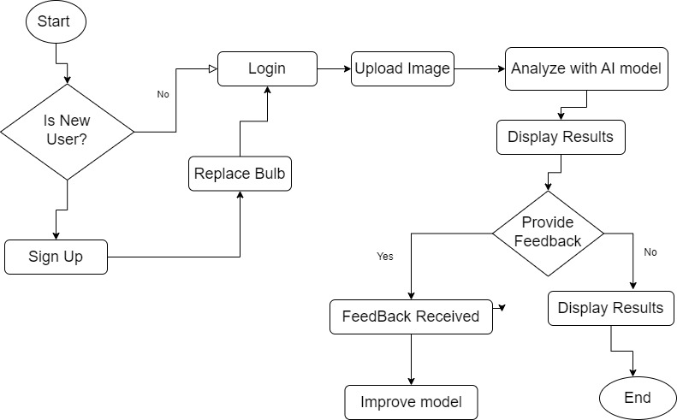
User Flow

Slide 18
Materials Requirements and Logistics
1
2
3
Hardware
High-performance GPUs or TPUs for faster and efficient model training. Like a Laptop.
Software
Python programming language, TensorFlow or PyTorch for machine learning, and relevant libraries.
Dataset
BigDatasetGan dataset both AI-generated and authentic images for comprehensive model training.

Slide 19
Resource Requirements
4
5
6
Integrated Development Environment
(IDE) like Jupyter Notebook or Visual Studio Code.
Cloud Services
AWS, Google Cloud, or Microsoft Azure for cloud computing services as storage for handling large datasets.
Collaboration Tools
Version control tools like Git, communication platforms like Slack or Microsoft Teams for effective teamwork.

Slide 20
Expected Output
A robust and adaptive detection system in the form of a website, capable of discerning between authentic and AI-generated images.
A high accuracy and reliability in identifying deceptive content.
.

Slide 21


Slide 22
Project Cost
Ghs 0
Dataset Retrieval and acquisition.
Ghs 500
Software subscription and cloud storage services.
Ghs 800
Domain name and hosting Services

Slide 23
Conclusion
Our project to detect AI-Generated images stands as a significant endeacor with far-reaching implicaions for online security and authentucuty as we navigate the dynamic landscape of digital interactions.

Slide 24
References
[1] William marcellino, nathan beauchamp-mustafaga, amanda kerrigan, lev navarre chao, jackson smith. (RAND) The rise of generative AI and the coming Era of Social media.
[2] Li, Y., Chen, X., & Lin, Z. (2020). Distilling Knowledge in GAN-Generated Image Detection via Neural Networks. arXiv preprint arXiv:2001.09878.
[3] Wang, X., & Zhang, Y. (2021). GAN-Generated Image Detection Based on the Analysis of Image Quality and Artifacts. arXiv preprint arXiv:2106.11114.

Slide 25
References
[4] Tian, Z., & Ye, S. (2022). Deep Image Forensics: A Survey of Image Manipulation Detection and Benchmarking. IEEE transactions on pattern analysis and machine intelligence, 44(9), 2382-2405.
[5] Zhang, Y., & Shen, J. (2023). Towards Robust Detection of GAN-Generated Images with Attention-Guided Network. arXiv preprint arXiv:2301.02700.
[6] Yu, R., Wang, Z., & Tan, X. (2019). Detecting GAN-Generated Images Using CNN - Based Features. arXiv preprint arXiv:1905.05715.

Slide 26
References
[7] Image splicing detection based on convolutional neural networks (Ye, D., Qian, Y., Long, R., & Shan, J., 2018).
[8] Image manipulation detection based on noise residual maps (Li, Y., Chang, S., & Chen, S., 2019).
[9] Image forensics based on error level analysis (Wang, S., Wu, D., & Zhang, Y., 2020).
[10] Image forensics using residual convolutional neural network (Afroz, S., Afroz, M. S., & Yamagishi, T., 2021)

Slide 27
References
[11] Image manipulation detection based on attention-based convolutional neural network (Liu, Y., Deng, S., & Wang, Z.-J., 2022).

